Slide 1
RESTAURANT Billing System
By
Md. Altamash Danyal (2106036)
Md. Dilshad Alam (2106037)
Shubham Kumar (2106070)
Md. JUned Eqbal (2106124)
Prakash Kumar(2106132)

Slide 2
Introduction
The project is “Restaurant Billing System" software for monitoring and controlling the transactions in a Restaurant. Billing System is a windows application designed to help users maintain & organize Restaurant. The system processes transaction and stores the resulting data. Reports will be generated from these data which help the manager to make appropriate business decisions for the restaurant.

Slide 3
List Of Some features
1)To take orders
2) To add item
3) To remove item
4) To edit item
5) To display menu
6) To show bill
7) To display total sale reports

Slide 4
Objective of Restaurant billing System
Take Orders: User will take orders from the customer, and only order will be taken at a time. After taking the order system will ask the customer whether to add more item in the order if yes, items will be added and bill will be displayed.
Add Item: If Restaurant staff wants to the add any item in the menu list, they can add through this function. It’ll first ask to enter item code and then to enter the price of the item. Then the new item wil be added to the menu.
Edit Items: If the management of the Restaurant wishes to edit the already added items in the menu, they can edit it through this function. It could be the code of the item or the price

Slide 5
Objective of Restaurant billing System
Delete Items: If the Restaurant has to remove some of it items from the menu list that they are no longer offering they can delete that item from this menu by entering the item code.
Display Menu: When the customers come to give the order, menu will be displayed to them with their prices.
Show Bill: If the management of the Restaurant wants to search a specific bill, they can search that bill by entering the bill number.
Total Sale Report: If the owner of the Restaurant wishes to see his total sale report he can check the report through this function, which will display all the bills with their numbers.

Slide 6
Need For Restaurant Billing System
Simple Menu Setup
User friendly Order Management
Customer management
Better Customer Service

Slide 7
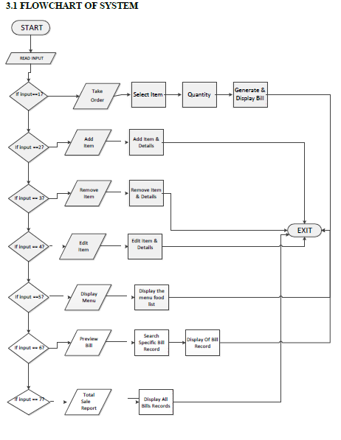
Data Flow Daigram

Slide 8
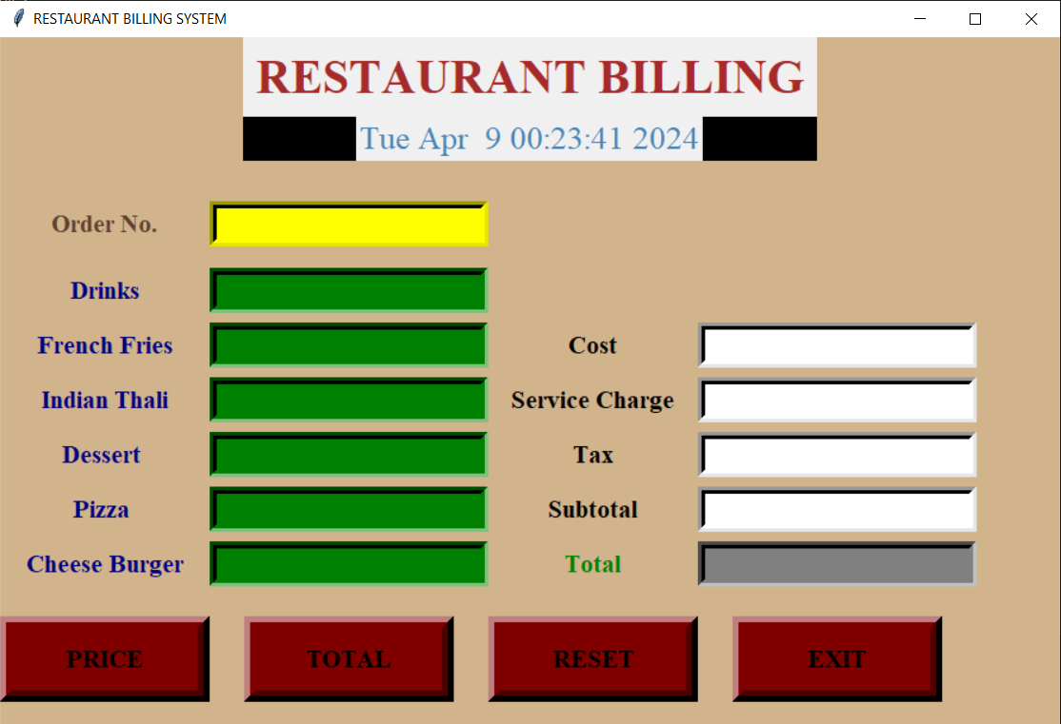
Interface

Slide 9
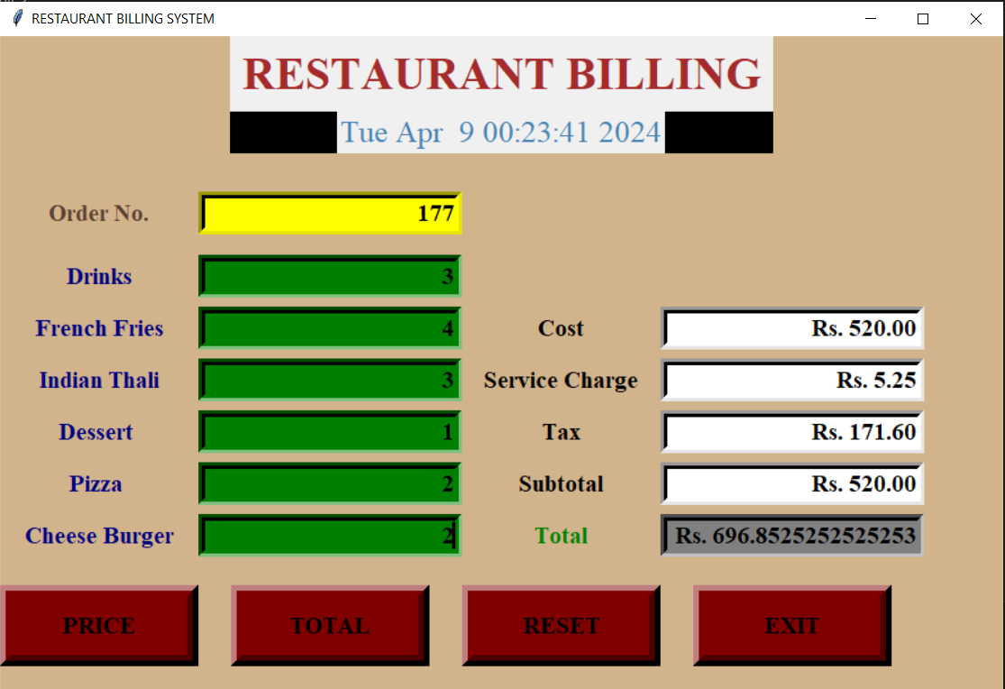
Interfrace

Slide 10
Hardware & Software Requirement
AMD Ryzen 7 5700U PROCESSOR
OPERATING SYSTEM WINDOWS 7/8/10/11
MEMORY 500MB-1GB RAM
HARD DISK SPACE AN HDD FOR PERMANENT STORAGE

Slide 11
CONCLUSION AND FUTURE WORK:
Conclusion:
To conclude, this project helps to maintain the record for any particular restaurant or Restaurant. It is an
advance and user-friendly interface, which will manage all orders and menu of the Restaurant. It helps to take
orders and display order and show bill. This also allows adding item, deleting item, editing item and
displaying menu. It helps in ordering food, which leads to bill generation. It will help several restaurants
to take orders of customers easily and it helps user to generate bill according to the quantity of food items.
This project is aim at developing an efficient food ordering system, which can be use in small places. It is
also use to simplify their operational and managerial tasks. It also helps to store the records of all the bills
generated for further analysis. Overall, it will help both user and customers and it will simplify the phase
of ordering food.

Slide 12
Thank you

